Slide 1
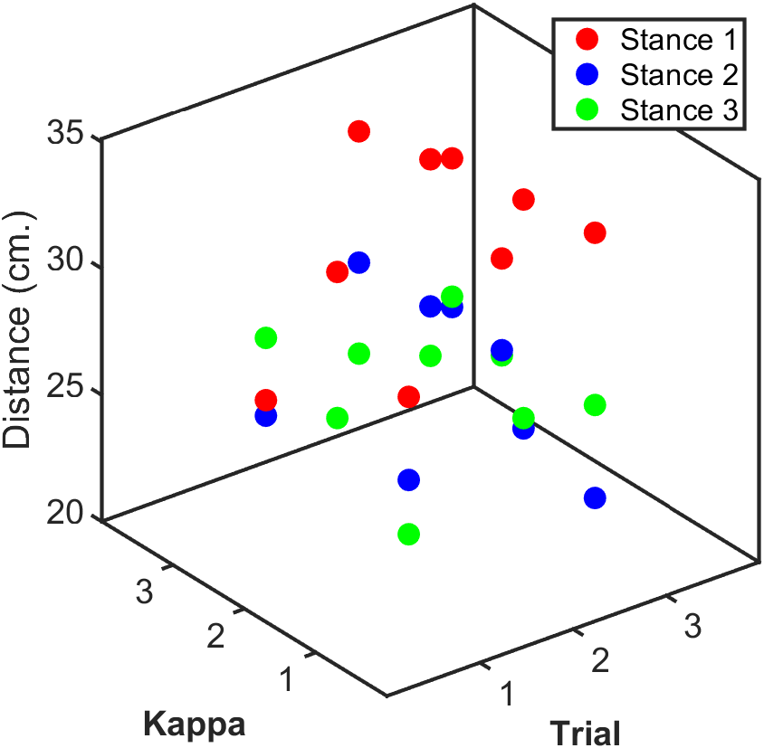
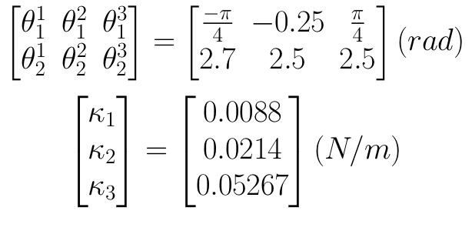
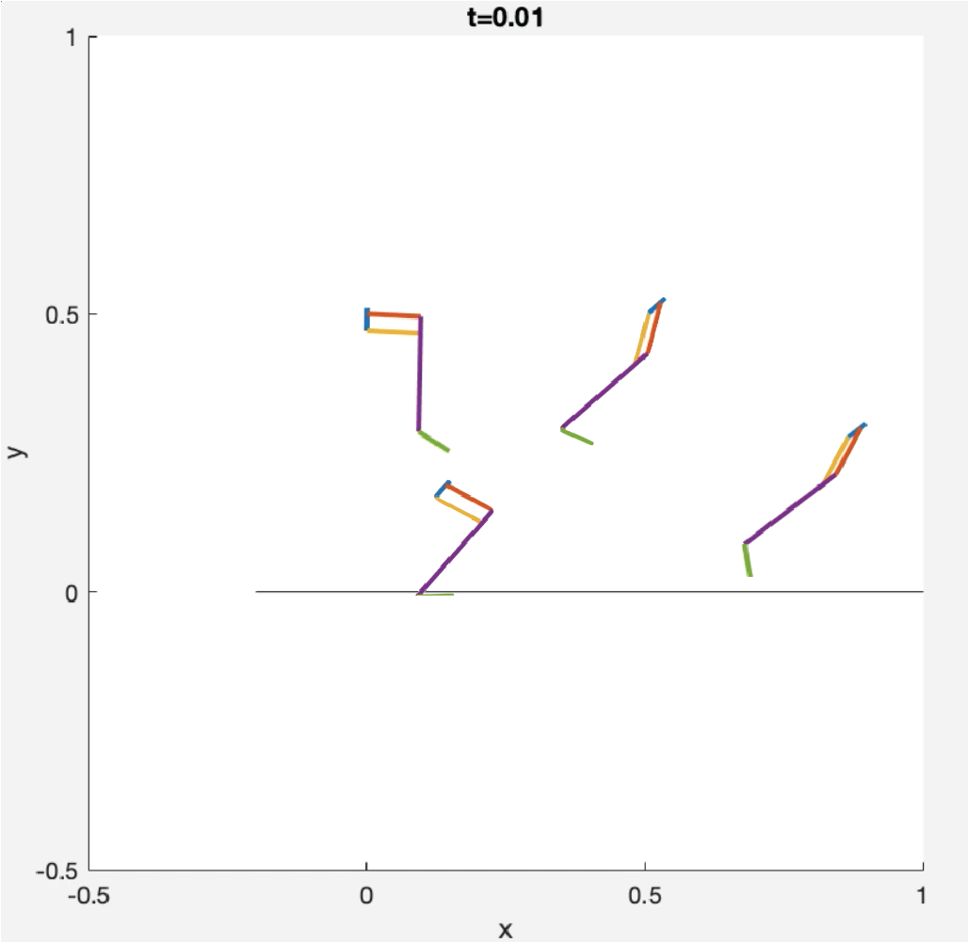
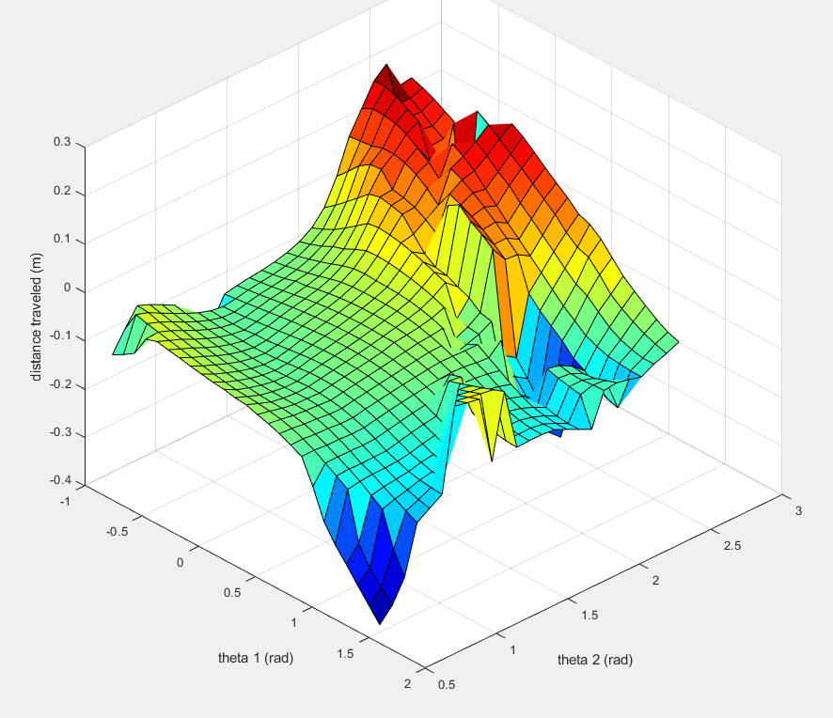
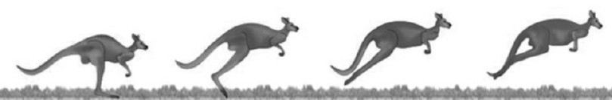
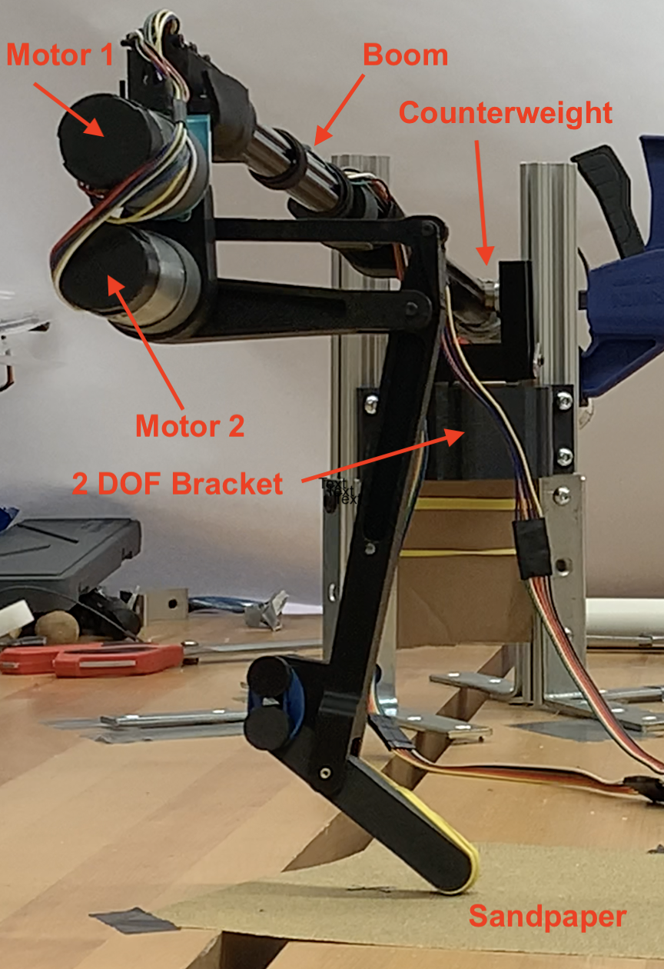
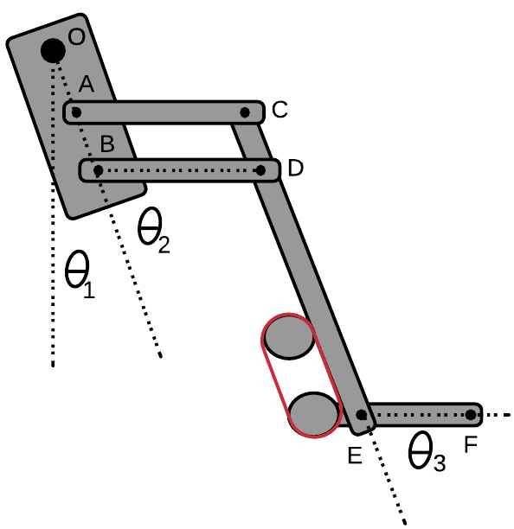



Effects of Crouch Angle and Ankle Stiffness on Horizontal Jumping Distance
Team Name: Steven Herrera, Jose Lavariega, Sandra Villagrana, Robert Williamson
Introduction
Simulation Results
Experimental Results
Jumping from a standing start is common for hopping animals, like kangaroos. As a kangaroo prepares to jump, it will squat into a loaded position and start to lean forward before leaping. How does the ankle stiffness, initial hip angle, and initial knee angle affect horizontal jumping distance?
Hypotheses:
Too high ankle stiffness won’t allow the leg to properly load and too low stiffness won’t store enough energy to launch the leg.
The initial hip angle will have more of an effect on the jump distance than the knee angle.
System Modeling:
We used Lagrangian equations of motion with 1ms time step Euler integration and discrete contact joint limits and discrete ground contact forces.
PD Control Architecture: 3-Phase Jump
1) Squat to starting configuration
2) Initiate jump with joint-space
set-point change
3) Adopt landing configuration in flight
Parameter Sweep:
$$−1≤\text{θ}\text{1}≤2 rad$$
$$0.5 ≤\text{θ}\text{2}≤3 rad$$
$$0.00667≤k≤0.02667 N/m$$
Our simulation yielded a consistent trend relating squat angle to horizontal jump distance across all values for kappa. We saw that the jumping distance increased greatly when the squatting configuration sat around $\text{θ}\text{1}=−0.5 rad \text{and} \text{θ}\text{2}=2.5 rad$. Once the squat configuration deviated from these angles, the leg would jump mostly vertically and lose its horizontal velocity.
Jumping Phases K = 0.0088 N/m
We converted the measured chord length to arc length to get the distance traveled.
When we vary $\text{θ}\text{1}$, the steeply sloped region where $\text{θ}\text{2}$ varies from 2.5 to 3 rad yields the full range of distances achieved by the leg. The experimental results agreed with the simulation results as these simulated distances match the experimental data. The ridge at the edge of $\text{θ}\text{2}$ = 2.5 provides an interesting feature of further study.
$\text{θ}\text{1}$ during the squat phase had a large impact on the direction of the jump whereas $\text{θ}\text{2 }$ impacted the magnitude of the jump. To maximize the horizontal jumping distance, ground friction should be maximized, ankle stiffness should be high enough to store energy but small enough to allow the foot to remain in contact with the ground, $\text{θ}\text{1}$ should be negative, and $\text{θ}\text{2}$ should be as high as possible to deepen the squat as much as possible.
R. Mayer. “Advanced Principles of Multimedia Learning.” The Cambridge Handbook of Multimedia Learning. (2014)
Kim, Sangbae. “2.74 Homework 4” (2021)
Discussion
Simulation Methods
Experimental Methods
Setup:
We used a boom to constrain the leg to just two axes of motion and counterweight to balance out the weight of the boom and mounting brackets. We wrapped the foot in rubber bands and used sand paper under the foot to increase the coefficient of friction of the ground.
Data Collection:
We used three squat configurations and at each configuration tested three different ankle stiffnesses three times for a total of 27 tests.
Conclusion
References

